Slide 1

1
Binary Search Trees
Notes:
Production Notes: Cheryl will be off screen and will speak to introduce the lesson.
Cheryl Notes:
“Welcome. This video introduces Binary Search Trees”

Slide 2

Binary Search Trees
7
1
9
0
3
8
10
2
5
4
6
Notes:
Production Notes: Cheryl on screen.
Cheryl Notes:
In a Binary Search Tree All elements in the left subtree precede those in the right subtree
And remember that every node is the root of a subtree.
So for every node, all the descendants to the left are smaller and all the descendants to the right are larger

Slide 3
Binary Search Trees
7
1
9
0
3
8
10
2
5
4
6
Notes:
Production Notes: Cheryl off screen.
Cheryl Notes:
Here is the algorithm for finding an item in a binary search tree
Recall that a perfect binary tree has a height of O(log n). The longest possible search is equal to the height of the tree.
We estimate the computational complexity of searching a binary search tree to be O(log n)

Slide 4
Binary Search Trees
7
8
10
12
Notes:
Production Notes: Cheryl on screen.
Cheryl Notes:
If a tree is not very full, performance will be worse
Searching a tree with only right subtrees, for example, is O(n)

Slide 5
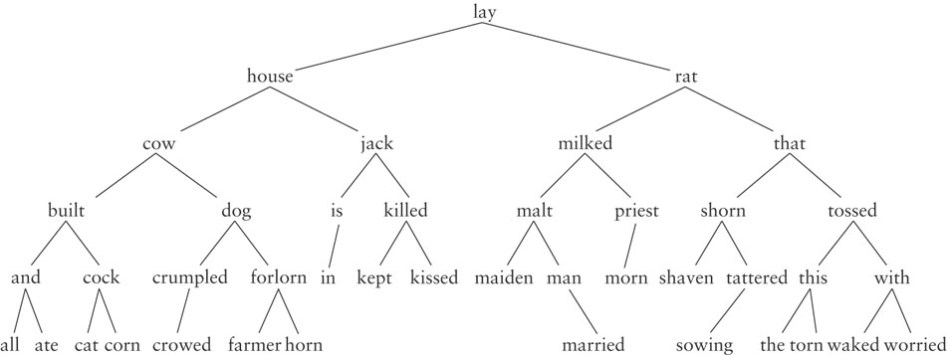
Binary Search Tree
Notes:
Production Notes: Off screen
Cheryl Notes:
Here is a binary search tree with strings where the ordering is alphabetical

Slide 6
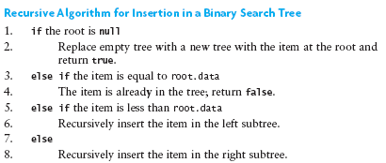
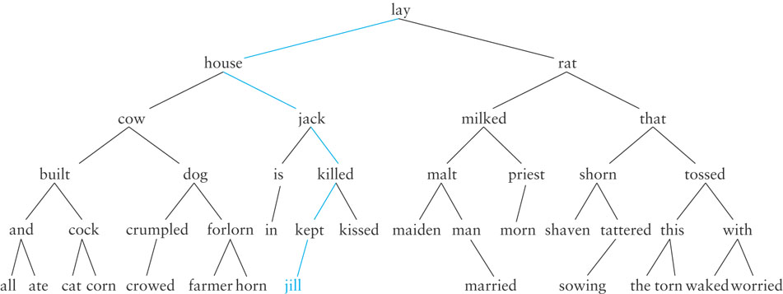
Inserting into a Binary Search Tree
Notes:
Question – Do you want these to overlap? We can use animations to have the back one disappear or we can separate the information by putting each image on its own slide. I want them on the same slide, but I don’t want them to overlap
Production Notes: Cheryl off screen.
Cheryl Notes:
Here is the algorithm for insertion into a binary tree. Search for the place to put the new item until you get to a leaf node.
Then create a new node and add that as a child to the leaf node.
Here is our binary search tree of strings with “jill” inserted
What if I want to insert “horse” ? (Go through example with highlighter)

Slide 7
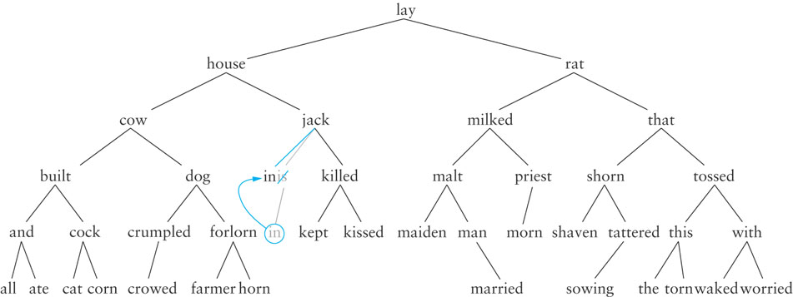
Binary Search Tree Removal
Notes:
Production Notes: Cheryl off screen
Cheryl Notes:
Next lets go over the removal algorithm.
There are three cases for removal: whether the item to be removed has no children, one child, or two children
If the item to be removed has no children, simply delete the reference to the item
(Point to “maiden”). If I want to delete “maiden”, I simply delete the node.
If the item to be removed has only one child, change the reference to the item so that it references the item’s only child
Here’s an example of removing “is”. It has one child, “in”. To remove “is” we replace the reference to “is” to that of “in”

Slide 8
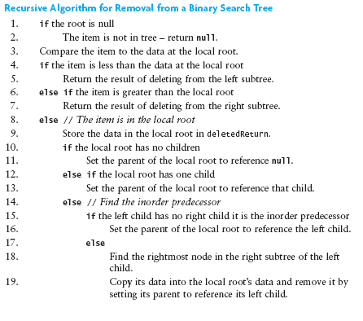
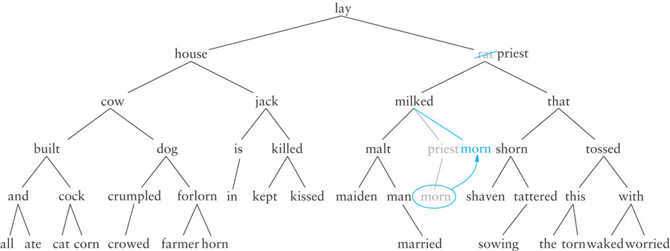
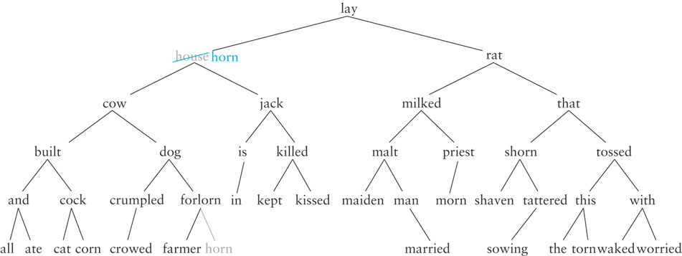
Binary Search Tree Removal
Notes:
Question – Did you want to be on screen the entire time or just for the third animation? We can separate the images onto their own slides, as well. Let us know. Off Screen
Production Notes: Cheryl of screen.
Cheryl Notes:
If the item to be removed has two children, replace it with the largest item in its left subtree – the inorder predecessor
Here’s an example where we remove “house”. The right-most child of its left subtree (demonstrate finding it) is “horn”.
We delete “horn” and replace “house” with “horn”.
CLICK
Here’s another example. To delete “rat” we find the right most node of its left sub tree. That’s “priest”.
To delete “priest”, we replace it with its child, “mourn”.
We then delete “rat” and replace it with “priest”.
And here is the algorithm for binary search tree removal.
CLICK
Let’s go to our visualization website and try out some examples.
https://www.cs.usfca.edu/~galles/visualization/BST.html

Slide 9

20
Notes:
Production Notes: Off screen.

